Slide 1

Analysis on the Legalization of Recreational Marijuana in the State of Colorado
UCI Data Analytics Bootcamp
Team 5
Josh, Peter, Sai, Stefanie
September 17, 2018

Slide 2
Does legal marijuana effect housing values?
Data Analysis Methodology
Housing values were downloaded from zillow.com. The “Housing Valuation Index (HVI)” was studied.
A list of marijuana stores was downloaded from colorado.gov. The primary data point used in this study was the physical location of the store (street, city and zip code).

Slide 3
CO Housing Price Trends 2012 - 2018
Coding logic
Step 1: Load Zillow housing data from csv into a dataframe
Step 2: Load marijuana stores data from csv into a dataframe
Step 3: Summarize data by decade and group by city
Step 4: Create 2 dataframes – one for cities with no MJ stores and one for cities with MJ stores
Step 5: Build a line graph that depicts overall housing price trends from 2012 – 2018 for the whole state, MJ cities and “dry” cities

Slide 4
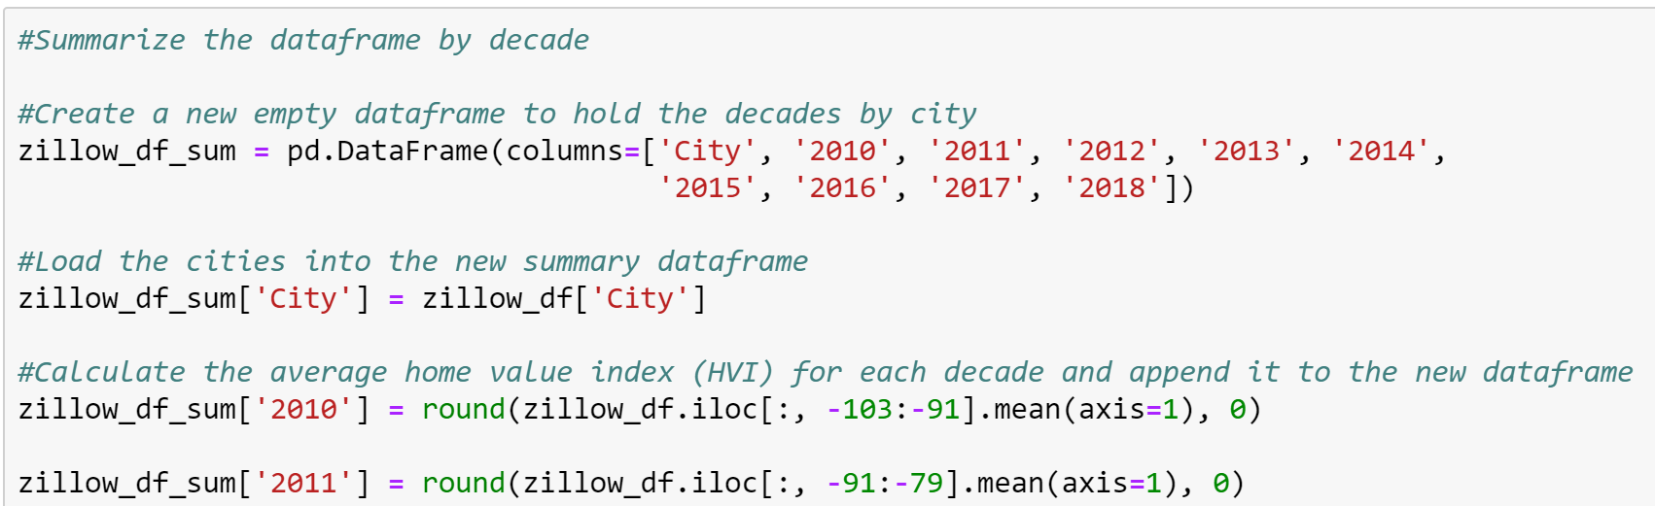
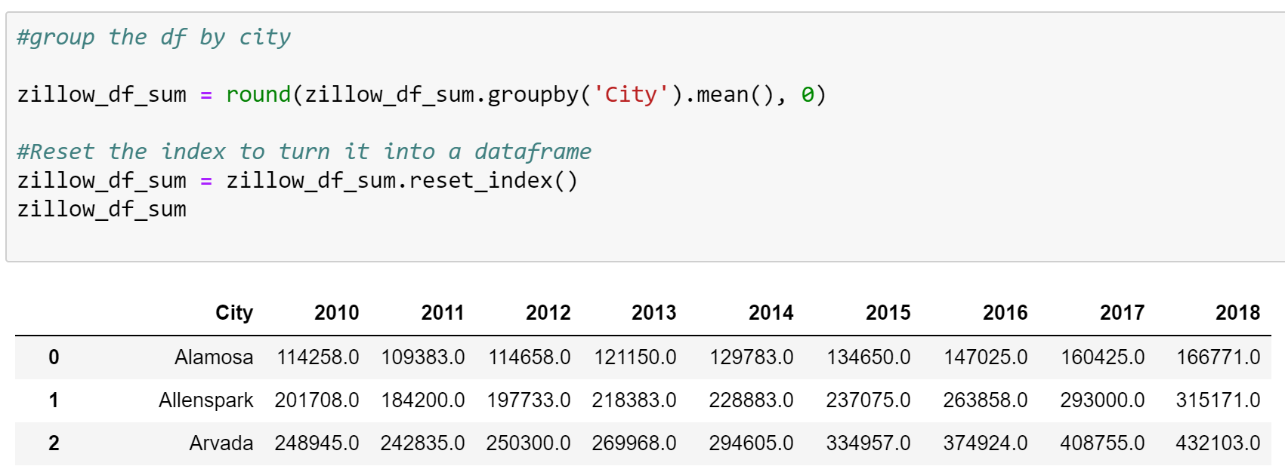
Code Snippets

Slide 5
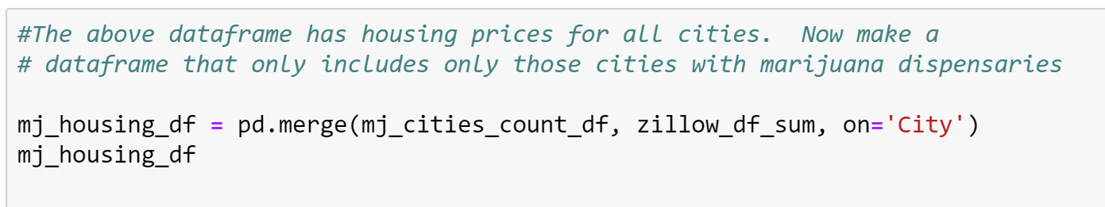
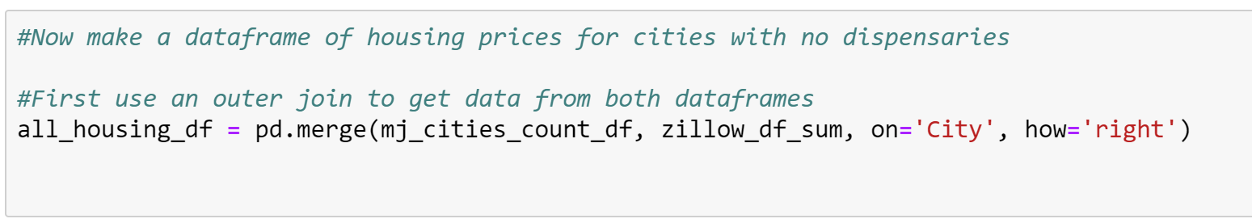
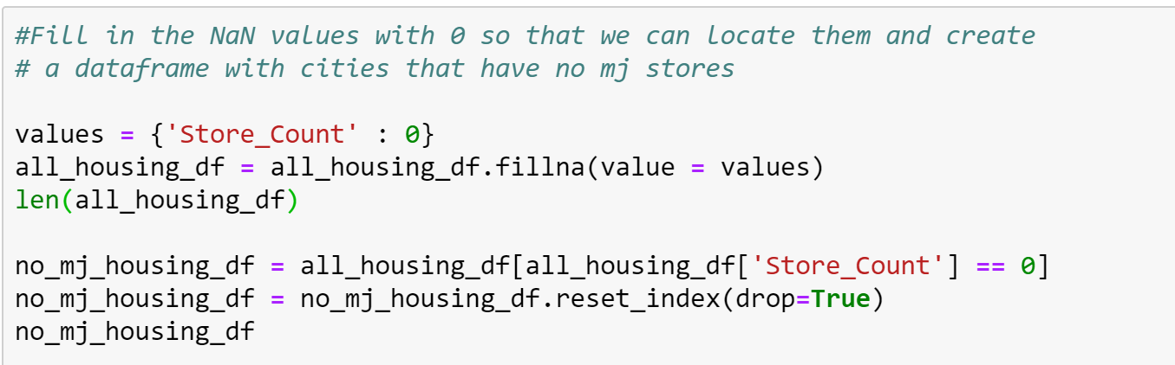

Slide 6
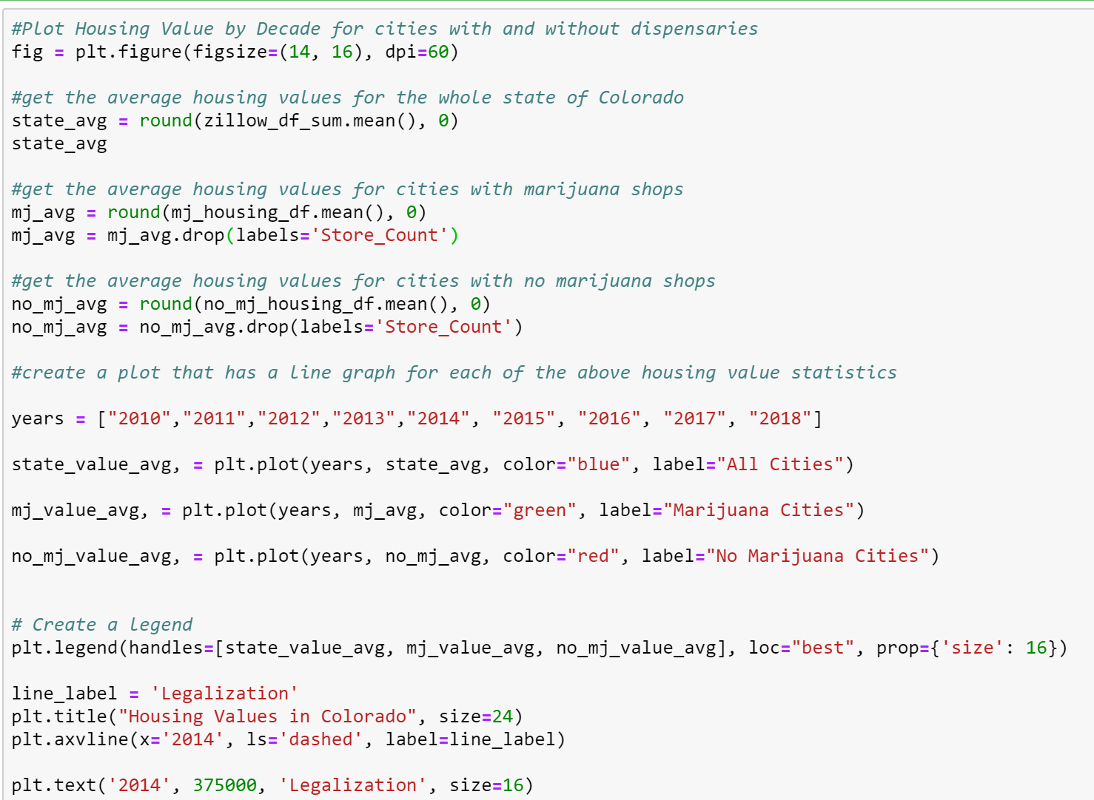

Slide 7
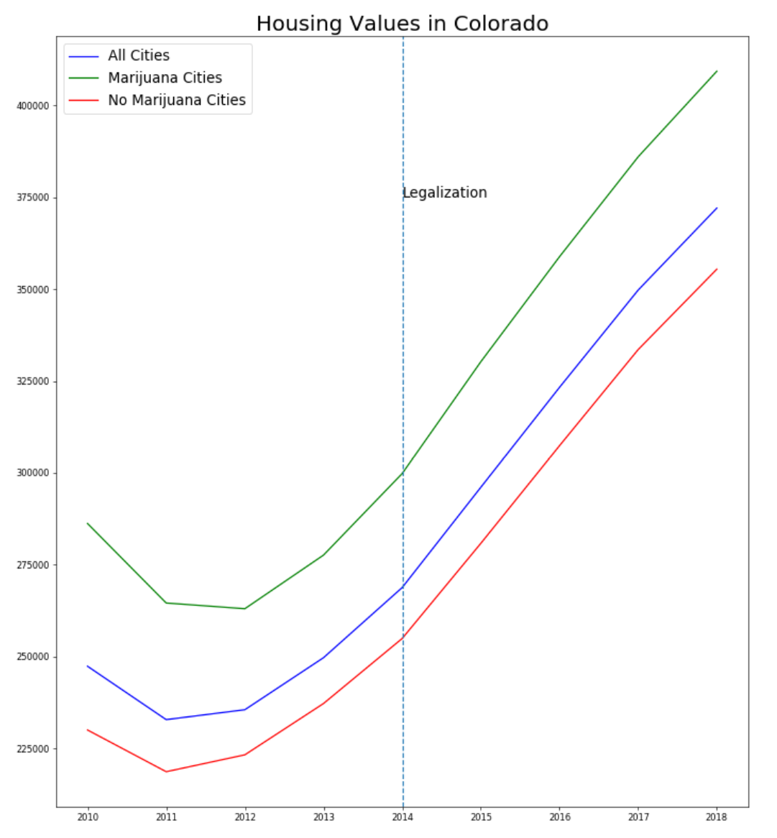
Analysis
Marijuana shops do not appear to affect housing values.
Prices in Colorado were trending up prior to the legalization of recreational marijuana, but after legalization they continued to skyrocket.

Slide 8
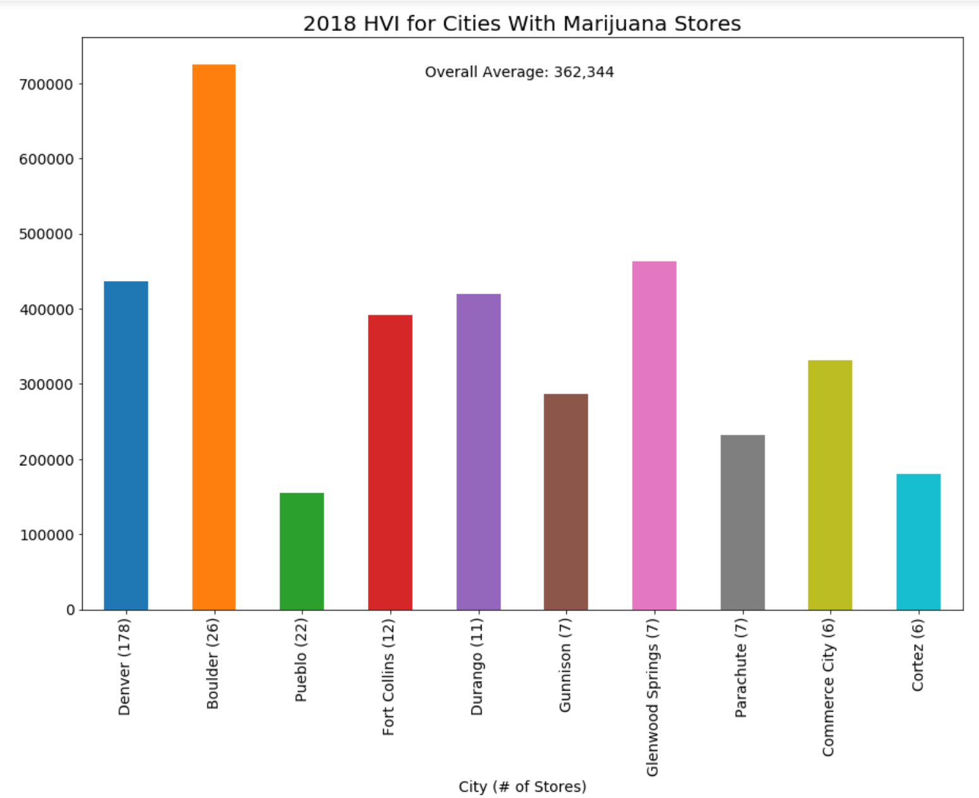
Analysis
Denver, Boulder and Pueblo have the largest number of marijuana shops. (The graph at left shows cities in order of shop #.)
There does not seem to be any correlation between the number of shops and housing prices.
Denver has a population of 719,116 and Boulder has a population of 109,068. This factor does not seem to influence housing prices either.

Slide 9
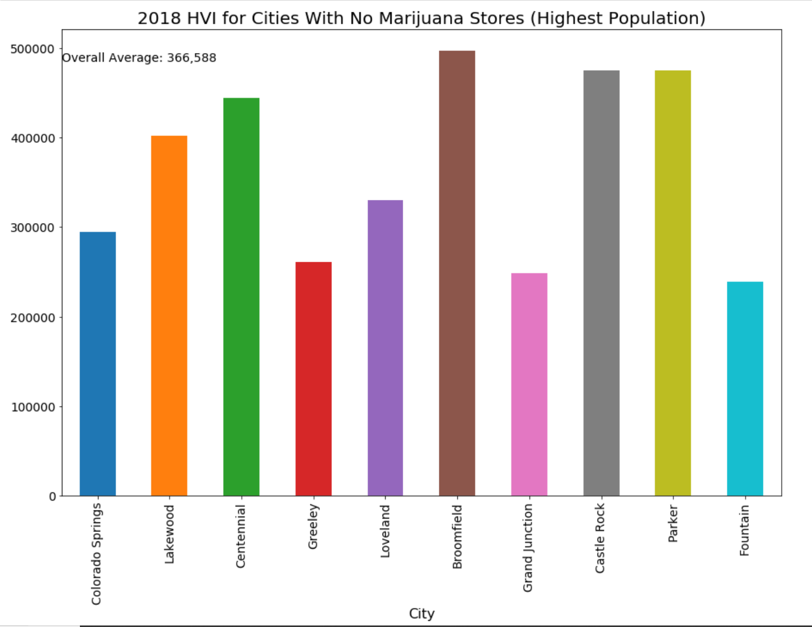
Analysis
For this analysis, we did not have any stores so we used population to decide which cities to include. We wanted to ensure that cities with a very small number of houses were not included as this could skew the housing prices.
The overall average housing price for cities with no marijuana shops is $366,588. This is extremely close to the prior graph (average price was $362,344). We can conclude that marijuana shops do not appear to influence housing prices.
influence housing prices either.

Slide 10
Does the legalization of commercial sale of marijuana affect median household income?
Data Analysis Methodology
Income data was downloaded from factfinder.census.gov.
Income data was gathered for the years of 2012-2016. We will be comparing the median household income of the years prior to and after the legalization of commercial sales of marijuana by looking specifically in areas where there is a presence marijuana dispensaries.

Slide 11
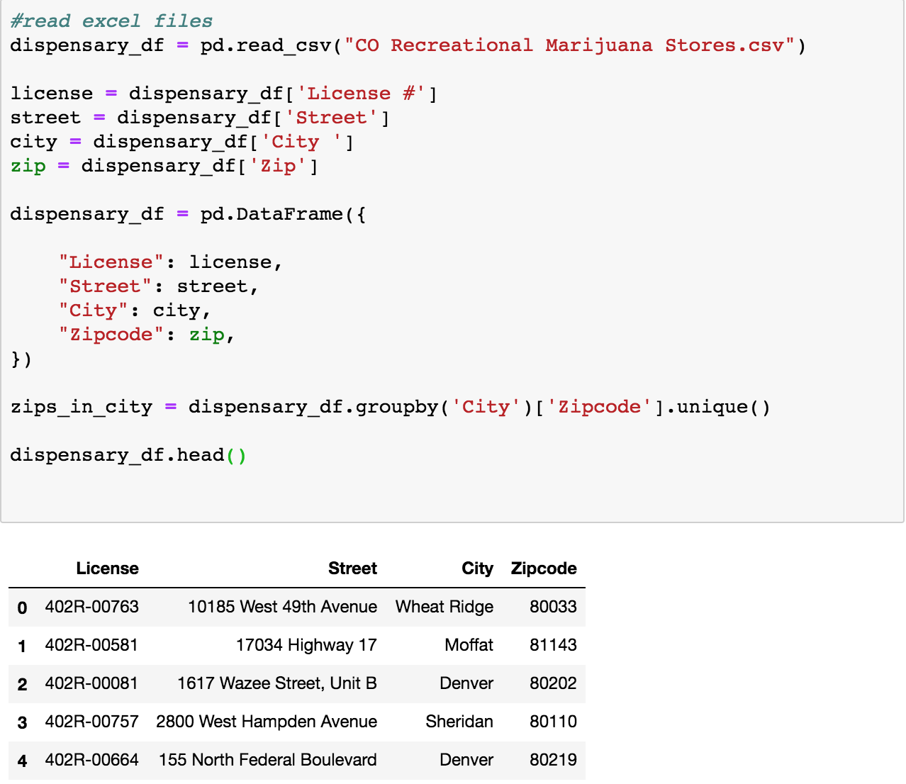
Code Snippets

Slide 12

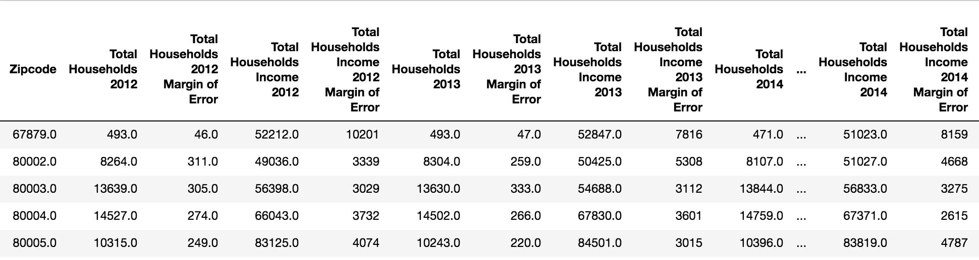
Code Snippets

Slide 13
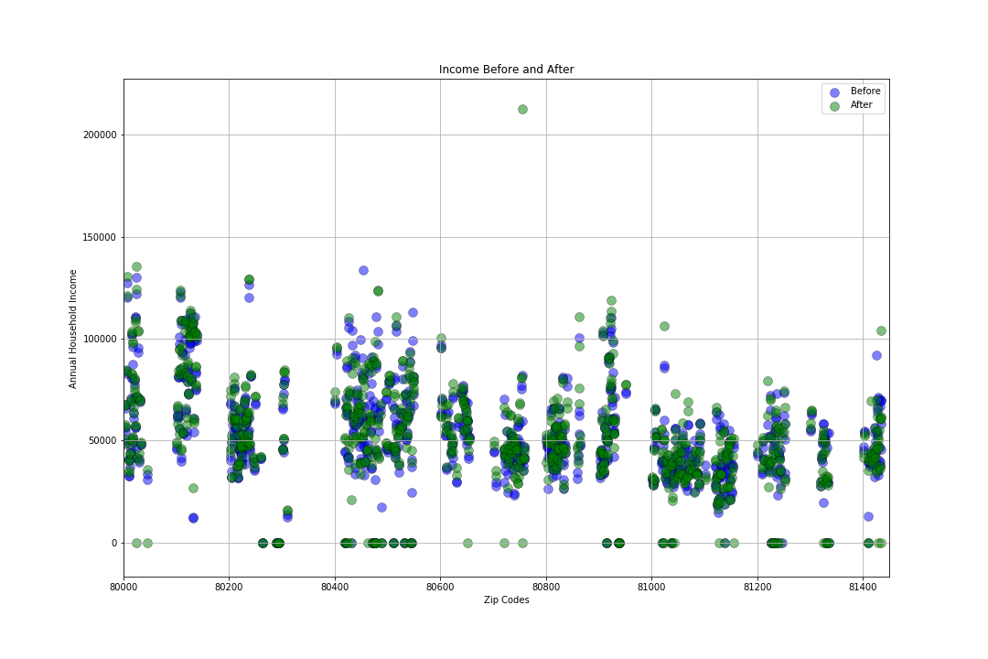
Analysis
Here, we plotted the median household income for each zip code. The blue markers represent income prior to the legalization of commercial sales
Based on the data, we concluded the legalization of commercial sale of marijuana had no observable impact on median household income

Slide 14
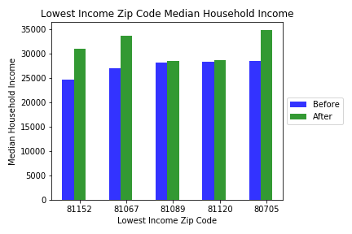
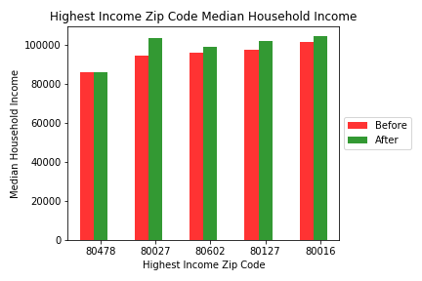
We calculated the average median household income for the years before legalization and the years after. We compared the before and after differences of the zip codes that had the lowest and highest median household income. The graphs show that income increased slightly for 7 out of the 10 samples.

Slide 15
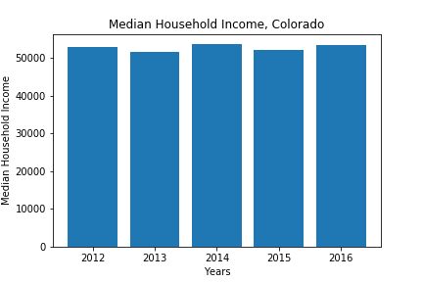
Analysis
This Bar Graph represents the aggregate of median household income for all zip codes. Legalization of commercial sales occurred in 2014 but as you can see, there is no noticeable difference in the years prior to and after legalization. This is further evidence that legalization had little or no effect on average household income.

Slide 16
Does the legalization of commercial sale of marijuana affect unemployment?
Data Analysis Methodology
Income data was downloaded from factfinder.census.gov.
Income data was gathered for the years of 2012-2016. We will be comparing the the unemployment rates for various age groups. We would like to see if the presence of marijuana dispensaries decrease unemployment rates through job creation or adversely increase unemployment rates

Slide 17
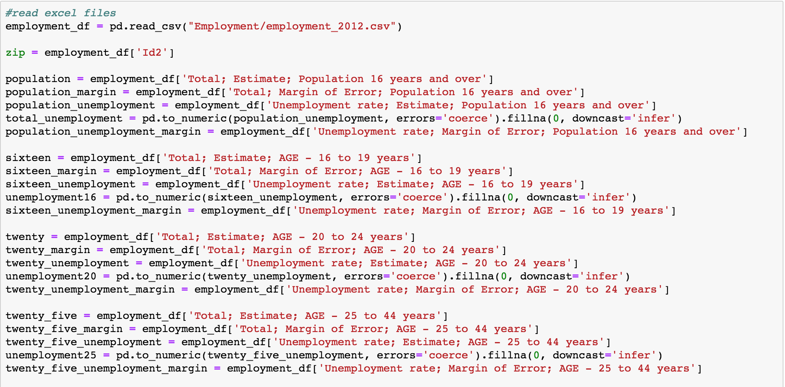
Code Snippets

Slide 18
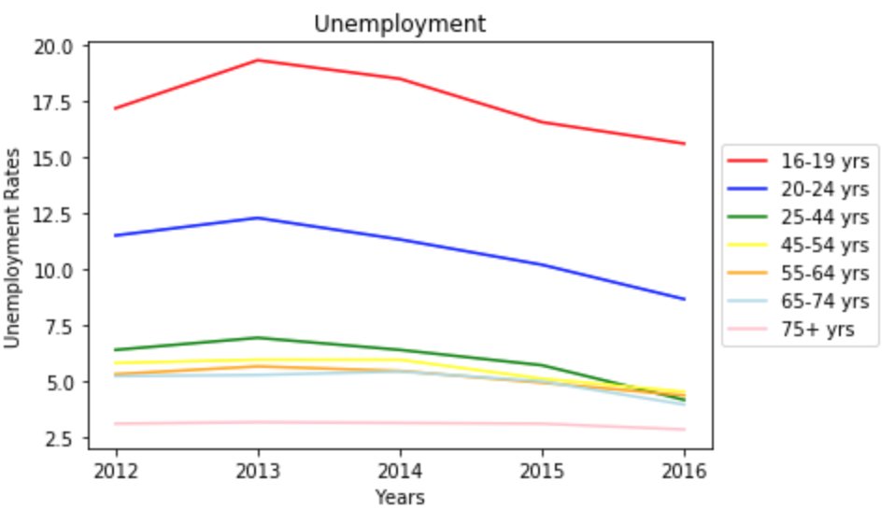
The legalization of commercial marijuana sales began in 2014 so that is our point of comparison. There appears to be a drop in unemployment rates for all age groups after legalization. Excluding all other factors that affect unemployment and unemployment rates, we can conclude the legalization of commercial sale of marijuana positively affects unemployment.

